Slide 1
2020 Welcome
to Invest in TAIWAN
Best Innovative Partner in Asia
https://investtaiwan.nat.gov.tw

Slide 2
Outline
Why Taiwan
Taiwan Foreign Direct Investment
Opportunities in Taiwan
Investment Services

Slide 3
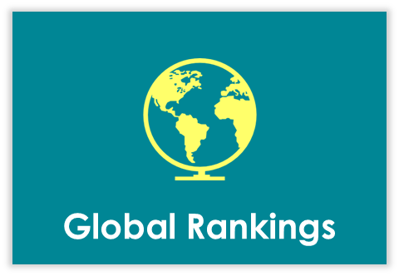
Why Taiwan
-Advantages Offered by Taiwan’s Investment Environment
#3 Best Destination for Investment
(2020 BERI Report)
#15 Ease of Doing Business
(2020 World Bank Doing Business Report)
#3 State of Cluster Development
(2019 World Economic Forum Global Competitiveness Report)
49% of Total Population has a Bachelor’s Degree or Higher
#3 Talent Ranking in Asia
(2020 IMD Talent Ranking)
#5 Graduate in Sciences
(2020 IMD Talent Ranking)
IP Regulations Meet International Standards
IP Police Dedicated to Enforcement
Trade Secrets Protection
Respect for IP Protection
Semiconductors
Displays
Machine Parts
Electronic Parts
Auto Parts

Slide 4
Why Taiwan
-Re-boost Economic Momentum
Taiwan’s semiconductor sector will invest US$ 90.67 billion in the future, making Taiwan a center for advanced semiconductor manufacturing processes.
Asian Tigers GDP Growth (2016-2020)
%
21st largest economy in the world
Outperformed other Asian tigers in 2019 & 2020
Source: International Monetary Fund

Slide 5
Why Taiwan
-Investment Incentives
Tax Incentives
R&D Subsidies
Business Income Tax 20%
R&D Investment Deduction (up to 15%)
5G/Smart Machinery Investment Deduction (up to 5%)
Patents & Copyright Royalties Are Income Tax Exempt
Support for Developing Smart Machinery/5G
A+ Industrial Innovative R&D Program
Taiwan Industry Innovation Platform Program
Global Innovation and R&D Partnership Program
Advanced Technology Research Plan
Small Business Innovation Research (SBIR)
Incentives for Global Talent
Special Zone Incentives
Provides Retirement, Health Insurance and Tax Benefits
Relaxed Work, Visa and Residency Regulations
Relaxed Residency Regulations for Parents, Spouses and Children
Free Trade Zones (FTZs)
Science & Industrial Parks
Agriculture Technology Parks
Export Processing Zones (EPZs)

Slide 6
Taiwan Foreign Direct Investment
Top Choice
for Multinational Enterprises
Approved FDI Statistics (2008-2019)
Billon USD
“When firms invest [in Taiwan], they feel confident that their intellectual property is safe, that trade secret protections will be enforced, that courts will adhere to the rule of law, and that the authorities are committed to shared democratic and free market values.”
- W. Brent Christensen, AIT Director
Source: Investment Commission, Ministry of Economic Affairs (R.O.C.)

Slide 7
Taiwan Foreign Direct Investment
Top 10 Countries for Approved Foreign Investment in 2020 (January-October)
Approved Foreign Investment by Industry in 2020
(January-October)
Billon USD
Source: Investment Commission, Ministry of Economic Affairs (R.O.C.)
*British Oversea Territories

Slide 8
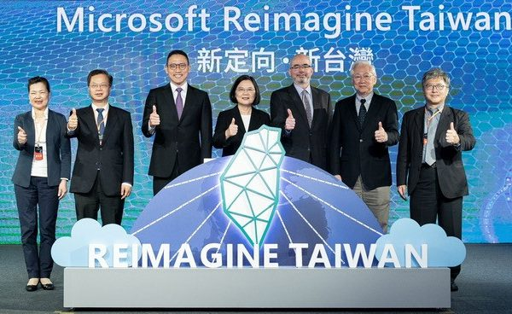
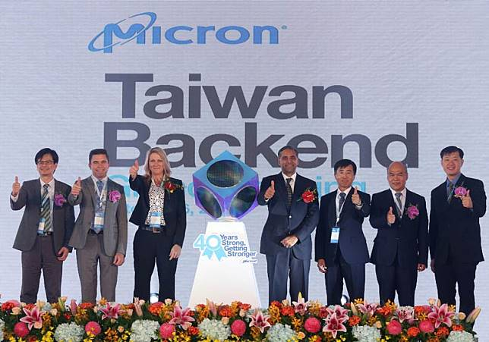
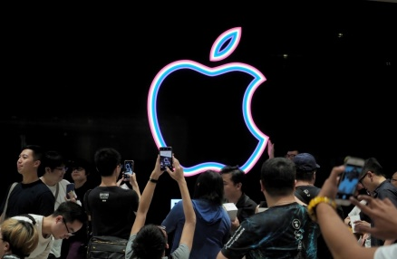
Successful Stories (2020)
Microsoft announced that it will increase its investment in Taiwan, and its cloud hardware and infrastructure team and information center will be based in Taiwan. The new investment is Microsoft's largest investment in Taiwan in 31 years.
Micron Technology, Inc. continued to invest in DRAM, wafer plants, and other technological developments in Taiwan, bringing new opportunities for cooperation and technology to Taiwan’s semiconductor industry.
Apple opened a new factory in May 2020, and continued work with Epistar and AUO to jointly invest in the research and development of new-generation display technology.

Slide 9
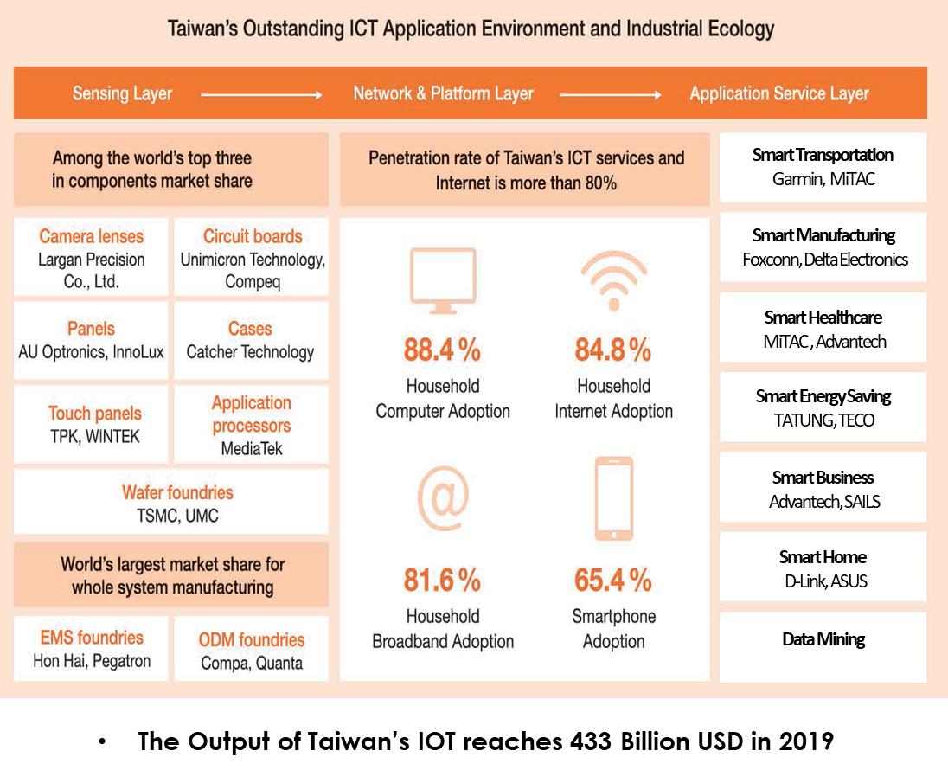
Opportunities in Taiwan
-Internet of Things
Taiwan’s Outstanding ICT Application Environment and Industrial Ecology
7
Taiwan’s IOT Output Value reached USD 43.3 Billion in 2019

Slide 10
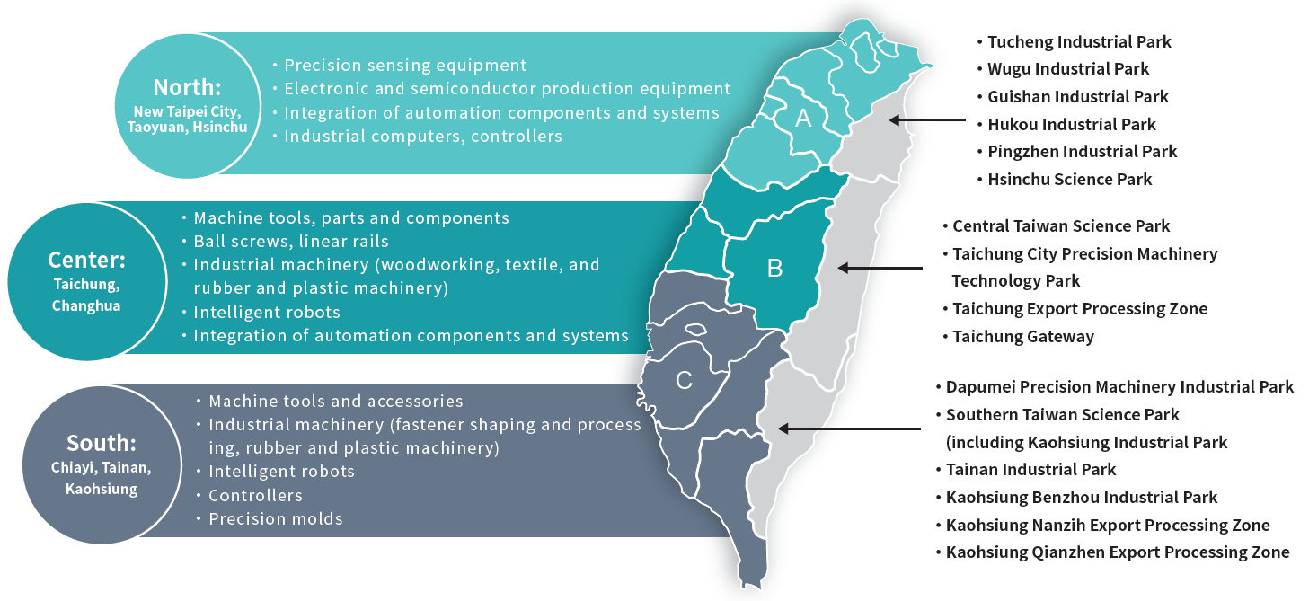
Opportunities in Taiwan
-Smart Machinery
Taiwan’s smart machinery application industry clusters
The output value of Taiwan’s machinery industry reached USD 36.67 Billion in 2019
The world’s highest demand for semiconductor equipment
World’s 7th largest machine tool manufacturing country
8

Slide 11
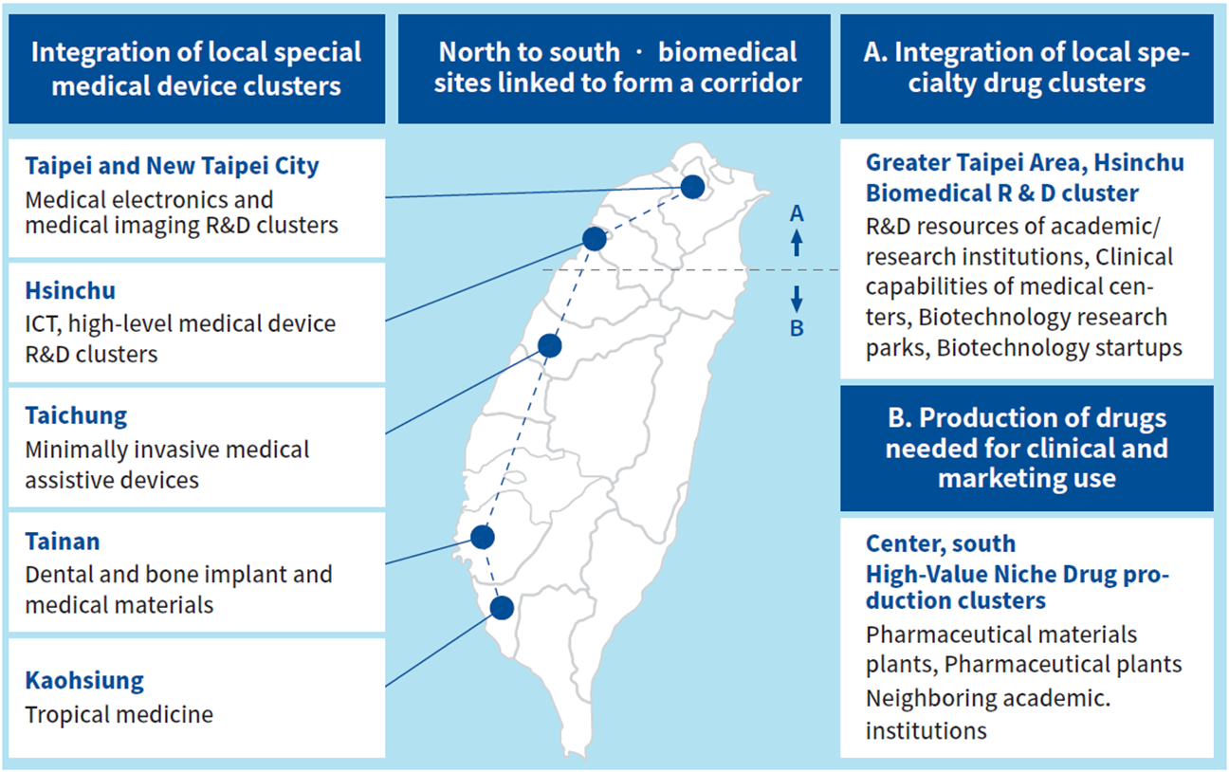
Opportunities in Taiwan
-Biomedicine
Health and Wellness
Operating Revenue
USD 6.48 Billion in 2019
Applied Biotech
Operating Revenue
USD 3.68 Billion in 2019
Pharmaceutical
Operating Revenue
USD 2.85 Billion in 2019
Medical Devices
Operating Revenue
USD 5.64 Billion in 2019
9

Slide 12
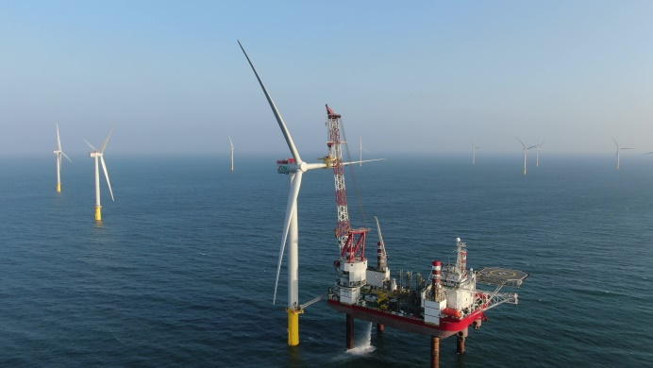
Opportunities in Taiwan
-Green Energy
Green Energy Will Account for 20% of Taiwan's Energy Mix by 2025 with Huge Potential to Grow Even Further
Business Opportunities in Renewable Energy Sector:
Photovoltaic Output Value: USD 2 billion in 2019
Wind Power Output Value: USD 471 Million in 2019
 | 2019 | 2025
Renewable energy | 6.8% | 20%
Nuclear energy | 11.8% | 0%
Coal | 46.1% | 30%
Fuel gas | 35.3% | 50%
Source: Risk Society and Policy Research Center, National Taiwan University
Taiwan’s First offshore wind power facility was launched in Nov. 2019
(Photo Credit: Formosa 1 Wind Power Co. Ltd)
10

Slide 13
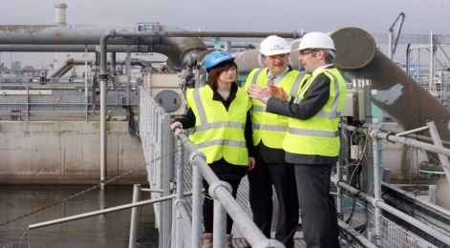
Opportunities in Taiwan
-Circular Economy
Reuse of Industrial Waste Reached 80% in 2019
Recycling Industry Output was around USD 2.45 Billion in 2019
3.3 Billion Government Investment in Circular Economy Demo Zone
Taiwan Boost Efforts in Circular Economy
11
Source: Industrial Development Bureau, MOEA

Slide 14
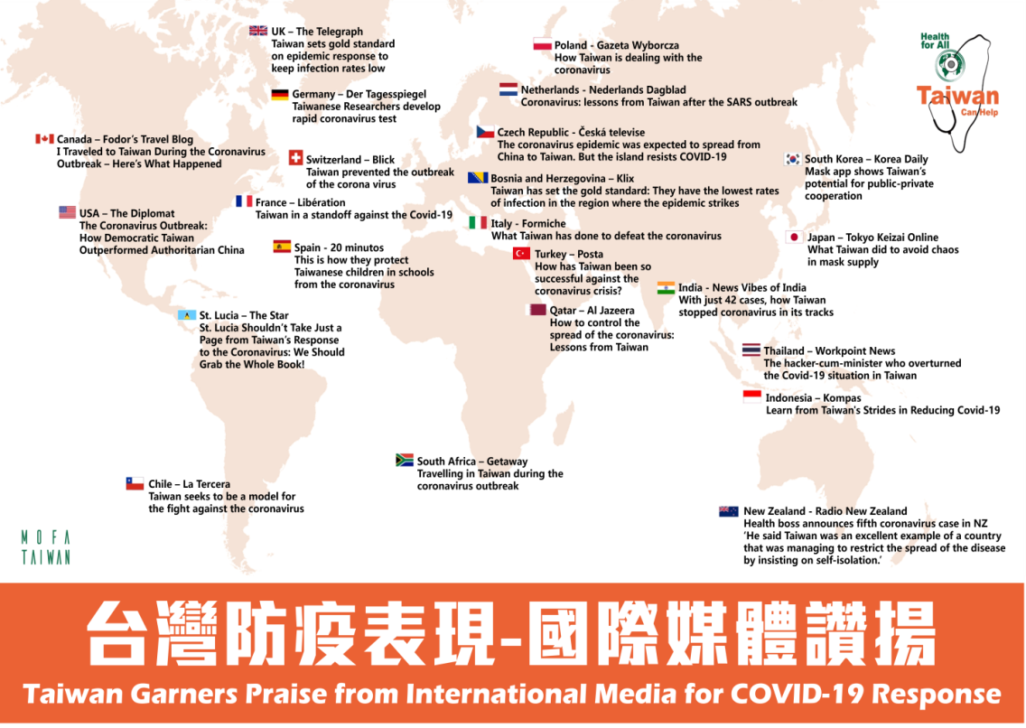
Taiwan’s Strengths- How Taiwan is combating COVID-19
#3 Best Place to be in the Coronavirus Era
(Bloomberg, 2020)
Set up 60 surgical mask production lines in 25 days Made possible by Taiwan’s comprehensive supply chain and strong machinery cluster
Established a surgical mask rationing system with real-time map Tapped into comprehensive health database and public-private collaboration
Best healthcare systems in world
(CEOWORLD, 2019)
World-leading medical personnel and advanced equipment
Taiwan Garners Praise
from International Media for COVID-19 Response
12

Slide 15
Investment Services
-Single Contact and Customized Services
Industrial Promotion Offices
Consultation/R&D/industry collaboration/new product development
Investors
Professional Consultants
Legal/accounting/tax code/environmental protection/engineering
One-Stop Service
Help in Finding Land
One-stop complete service and dedicated investment assistance
Assistance in acquiring land and improvement of matchmaking services
Reply Within 24 Hours
Inter-Agency Elimination of Obstacles
Local Governments
Remove investment barriers involving land, water, electricity, administrative procedures, etc.
Answers within 24 hours with online and offline integration
Elimination of investment obstacles at higher levels and across agencies
13

Slide 16
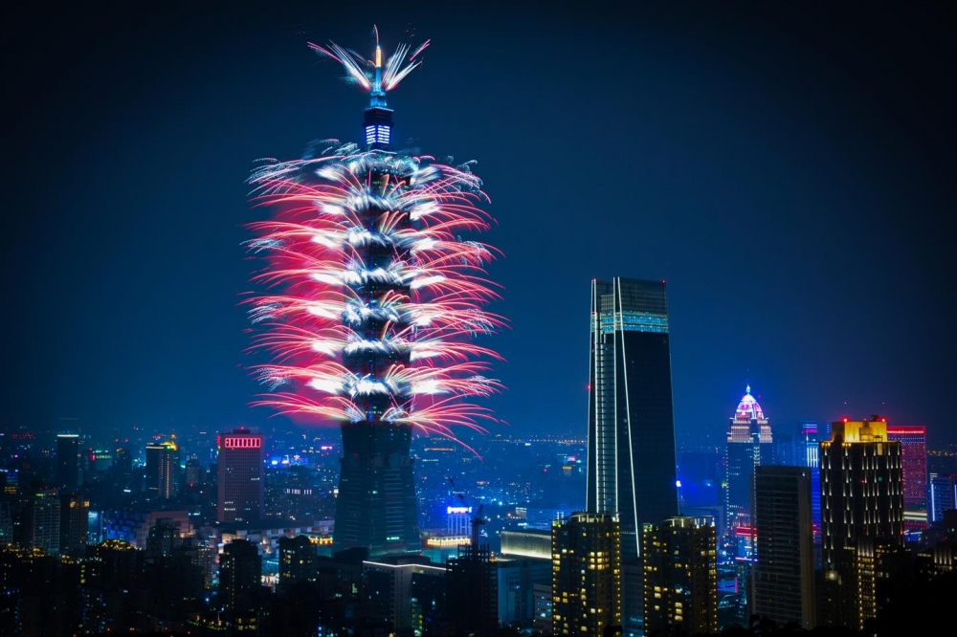
Best Innovative Partner in Asia
https://investtaiwan.nat.gov.tw

